Slide 1
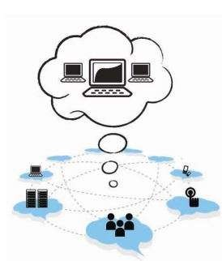
UNIT - 2

Slide 2
Cloud Computing Fundamentals
Motivation for Cloud Computing
The Need for Cloud Computing
Defining Cloud Computing
Definition of Cloud computing
Cloud Computing Is a Service
Cloud Computing Is a Platform
Principles of Cloud computing
Five Essential Characteristics
Four Cloud Deployment Models

Slide 3
Motivation for Cloud Computing
Let us review the scenario of computing prior to the announcement and availability of cloud computing.
The users who are in need of computing are expected to invest money on computing resources such as hardware, software, networking, and storage; this investment naturally costs a bulk currency to the users as they have to buy these computing resources, keep these in their premises, and maintain and make it operational—all these tasks would add cost.
And, this is a particularly true and huge expenditure to the enterprises that require enormous computing power and resources, compared with classical academics and individuals.

Slide 4
Continue…….
As one can easily assess the huge lump sum required for capital expenditure (whole investment and maintenance for computing infrastructure) and compare it with the moderate or smaller lump sum required for the hiring or getting the computing infrastructure only to the tune of required time, and rest of the time free from that.
Therefore, cloud computing is a mechanism of bringing–hiring or getting the services of the computing power or infrastructure to an organizational or individual level to the extent required and paying only for the consumed services.
.

Slide 5
Continue…….
One can compare this situation with the usage of electricity (its services) from its producer-cum-distributor (in India, it is the state-/government-owned electricity boards that give electricity supply to all residences and organizations) to houses or organizations; here, we do not generate electricity (comparable with electricity production–related tasks); rather, we use it only to tune up our requirements in our premises, such as for our lighting and usage of other electrical appliances, and pay as per the electricity meter reading value.
Therefore, cloud computing is needed in getting the services of computing resources. Thus, one can say as a one-line answer to the need for cloud computing that it eliminates a large computing investment without compromising the use of computing at the user level at an operational cost.
.

Slide 6
Continue…….
Cloud computing is very economical and saves a lot of money.
A blind benefit of this computing is that even if we lose our laptop or due to some crisis our personal computer—and the desktop system—gets damaged, still our data and files will stay safe and secured as these are not in our local machine (but remotely located at the provider’s place—machine).
one can think to add security while accessing these remote computing resources as depicted in below Figure.
.

Slide 7
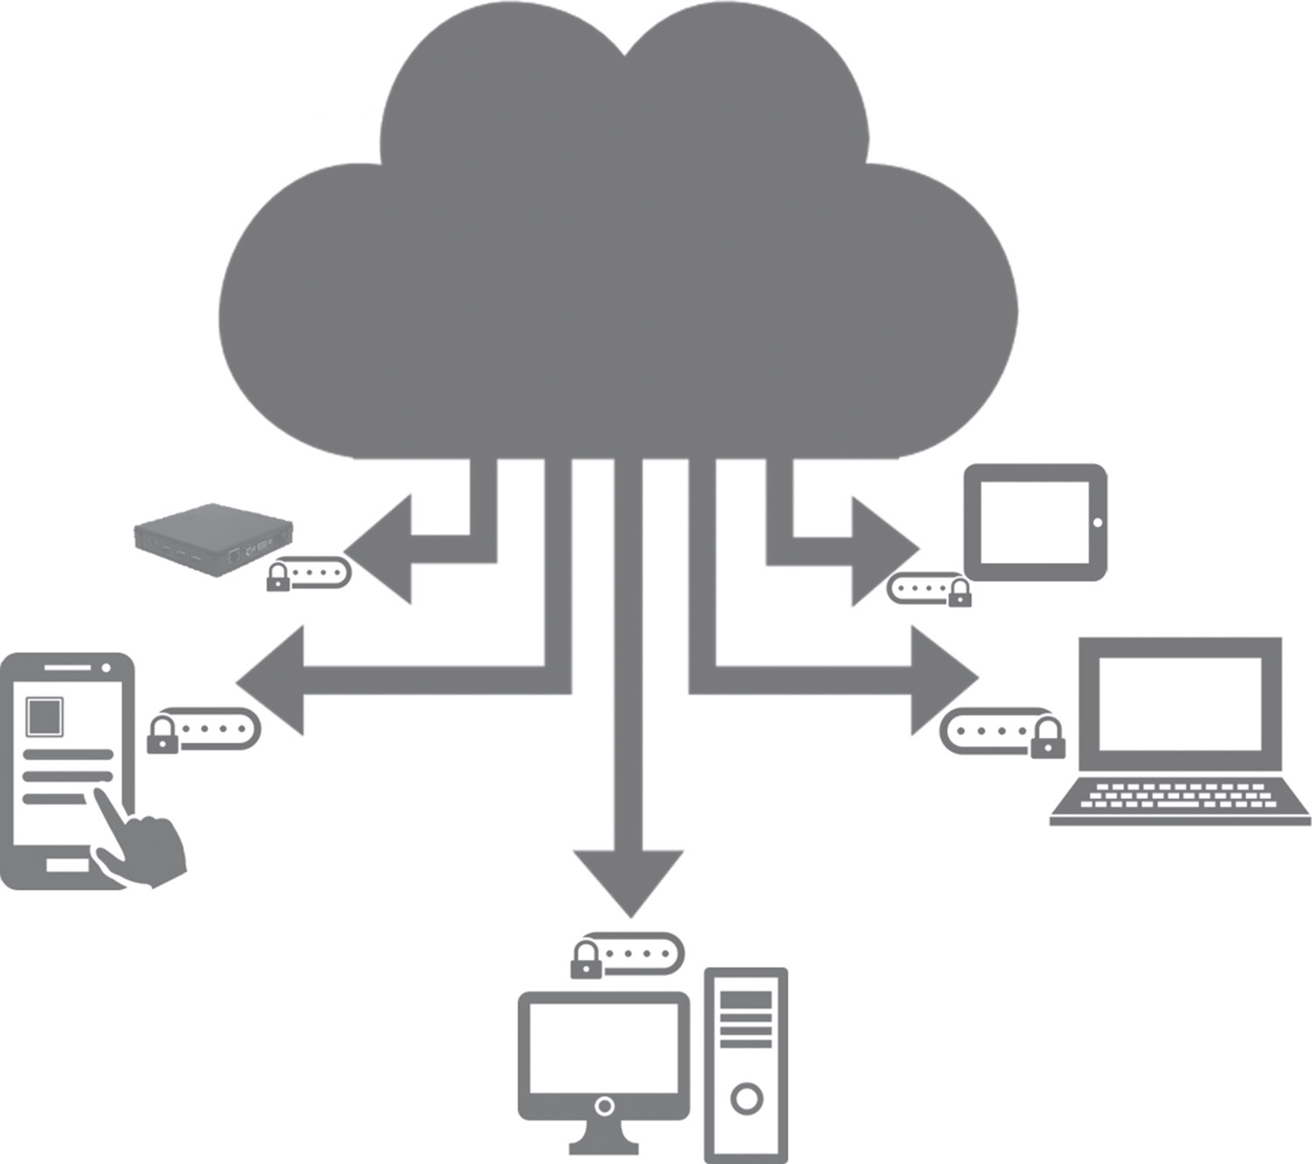
Continue…….
Document management , Email and office productivity Finance ERP, Social networks, Training, Business intelligence, Integration , Development and testing platform , Storage, Application deployment, Network . Database,
Compute.
.
Thin client
Tablet
Desktop
Smartphone

Slide 8
Continue…….
Above Figure shows several cloud computing applications.
The cloud represents the Internet-based computing resources, and the accessibility is through some secure support of connectivity.
It is a computing solution growing in popularity, especially among individuals and small- and medium-sized companies (SMEs).
In the cloud computing model, an organization’s core computer power resides offsite and is essentially subscribed to rather than owned.
.

Slide 9
Continue…….
Cloud computing comes into focus and much needed only when we think about what computing resources and information technology (IT) solutions are required.
This need caters to a way to increase capacity or add capabilities on the fly without investing in new infrastructure, training new personnel, or licensing new software.
Cloud computing encompasses the subscription-based or pay-per-use service model of offering computing to end users or customers over the Internet and thereby extending the IT’s existing capabilities.
.

Slide 10
The Need for Cloud Computing
The main reasons for the need and use of cloud computing are convenience and reliability.
In the past, if we wanted to bring a file, we would have to save it to a Universal Serial Bus (USB) flash drive, external hard drive, or compact disc (CD) and bring that device to a different place.
Instead, saving a file to the cloud (e.g., use of cloud application Dropbox) ensures that we will be able to access it with any computer that has an Internet connection.
The cloud also makes it much easier to share a file with friends, making it possible to collaborate over the web.
.

Slide 11
Continue….
While using the cloud, losing our data/file is much less likely. However, just like anything online, there is always a risk that someone may try to gain access to our personal data, and therefore, it is important to choose an access control with a strong password and pay attention to any privacy settings for the cloud service that we are using.
.

Slide 12
Defining Cloud Computing
In the simplest terms, cloud computing means storing and accessing data and programs over the Internet from a remote location or computer instead of our computer’s hard drive.
This so called remote location has several properties such as scalability, elasticity etc., which is significantly different from a simple remote machine.
The cloud is just a metaphor for the Internet. When we store data on or run a program from the local computer’s hard drive, that is called local storage and computing.
For it to be considered cloud computing, we need to access our data or programs over the Internet. The end result is the same; however, with an online connection, cloud computing can be done anywhere, anytime, and by any device.
.

Slide 13
NIST Definition of Cloud Computing
The formal definition of cloud computing comes from the National Institute of Standards and Technology (NIST):
“Cloud computing is a model for enabling ubiquitous, convenient, on-demand network access to a shared pool of configurable computing resources (e.g., networks, servers, storage, applications, and services) that can be rapidly provisioned and released with minimal management effort or service provider interaction.
This cloud model is composed of five essential characteristics, three service models, and four deployment models
.

Slide 14
Continue…
It means that the computing resource or infrastructure—be it server hardware, storage, network, or application software—all available from the cloud vendor or provider’s site/premises, can be accessible over the Internet from any remote location and by any local computing device.
In addition, the usage or accessibility is to cost only to the level of usage to the customers based on their needs and demands, also known as the pay-as-you-go or pay-as-per-use model.
If the need is more, more quantum computing resources are made available (provisioning with elasticity) by the provider. Minimal management effort implies that at the customer’s side, the maintenance of computing systems is very minimal as they will have to look at these tasks only for their local computing devices used for accessing cloud-based resources, not for those computing resources managed at the provider’s side.
.

Slide 15
Continue…
Many vendors, pundits, and experts refer to NIST, and both the International Standards Organization (ISO) and the Institute of Electrical and Electronics Engineers (IEEE) back the NIST definition.
Now, let us try to define and understand cloud computing from two other perspectives—as a service and a platform—in the following sections.
.

Slide 16
Cloud Computing Is a Service
The simplest thing that any computer does is allow us to store and retrieve information.
We can store our family photographs, our favorite songs, or even save movies on it, which is also the most basic service offered by cloud computing.
Let us look at the example of a popular application called Flickr to illustrate the meaning of this section.
While Flickr started with an emphasis on sharing photos and images, it has emerged as a great place to store those images. In many ways, it is superior to storing the images on your computer
.

Slide 17
Continue…
First, Flickr allows us to easily access our images no matter where we are or what type of device we are using. While we might upload the photos of our vacation from our home computer, later, we can easily access them from our laptop at the office.
2. Second, Flickr lets us share the images. There is no need to burn them to a CD or save them on a flash drive. We can just send someone our Flickr address to share these photos or images.
3. Third, Flickr provides data security. By uploading the images to Flickr, we are providing ourselves with data security by creating a backup on the web. And, while it is always best to keep a local copy—either on a computer, a CD, or a flash drive—the truth is that we are far more likely to lose the images that we store locally than Flickr is of losing our images.
.

Slide 18
Cloud Computing Is a Platform
The World Wide Web (WWW) can be considered as the operating system for all our Internet-based applications. However, one has to understand that we will always need a local operating system in our computer to access web-based applications.
The basic meaning of the term platform is that it is the support on which applications run or give results to the users.
For example, Microsoft Windows is a platform. But, a platform does not have to be an operating system. Java is a platform even though it is not an operating system.
Through cloud computing, the web is becoming a platform. With trends (applications) such as Office 2.0, more and more applications that were originally available on desktop computers are now being converted into
.

Slide 19
Continue…
Through cloud computing, the web is becoming a platform. With trends (applications) such as Office 2.0, more and more applications that were originally available on desktop computers are now being converted into web–cloud applications.
Word processors like Buzzword and office suites like Google Docs are now available in the cloud as their desktop counterparts.
All these kinds of trends in providing applications via the cloud are turning cloud computing into a platform or to act as a platform.
.

Slide 20
5-4-3 Principles of Cloud computing
The 5-4-3 principles put forth by NIST describe
the five essential characteristic features that promote cloud computing,
the four deployment models that are used to narrate the cloud computing opportunities for customers while looking at architectural models, and
(c) the three important and basic service offering models of cloud computing.
.

Slide 21
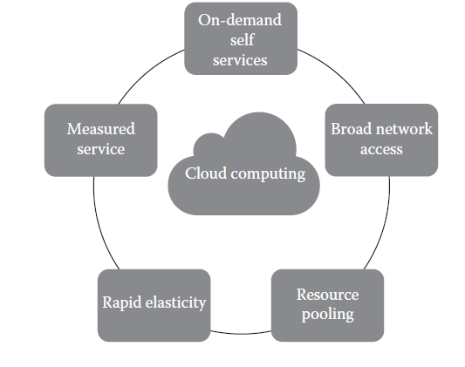
Five Essential Characteristics
Cloud computing has five essential characteristics, which are shown in below Figure.
Readers can note the word essential, which means that if any of these characteristics is missing, then it is not cloud computing
.

Slide 22
Five Essential Characteristics
On-demand self-service: A consumer can unilaterally provision computing capabilities, such as server time and network storage, as needed automatically without requiring human interaction with each service’s provider.
2. Broad network access: Capabilities are available over the network and accessed through standard mechanisms that promote use by heterogeneous thin or thick client platforms (e.g., mobile phones, laptops, and personal digital assistants [PDAs]).
.

Slide 23
Continue…
3. Elastic resource pooling: The provider’s computing resources are pooled to serve multiple consumers using a multitenant model, with different physical and virtual resources dynamically assigned and reassigned according to consumer demand.
There is a sense of location independence in that the customer generally has no control or knowledge over the exact location of the provided resources but may be able to specify the location at a higher level of abstraction (e.g., country, state, or data center). Examples of resources include storage, processing, memory, and network bandwidth.
.

Slide 24
Continue…
4. Rapid elasticity: Capabilities can be rapidly and elastically provisioned, in some cases automatically, to quickly scale out and rapidly released to quickly scale in. To the consumer, the capabilities available for provisioning often appear to be unlimited and can be purchased in any quantity at any time.
5. Measured service: Cloud systems automatically control and optimize resource use by leveraging a metering capability at some level of abstraction appropriate to the type of service (e.g., storage, processing, bandwidth, and active user accounts). Resource usage can be monitored, controlled, and reported providing transparency for both the provider and consumer of the utilized service.
.

Slide 25
Four Cloud Deployment Models
Deployment models describe the ways with which the cloud services can be deployed or made available to its customers, depending on the organizational structure and the provisioning location.
One can understand it in this manner too: cloud (Internet)-based computing resources—that is, the locations where data and services are acquired and provisioned to its customers—can take various forms.
Four deployment models are usually distinguished, namely, 1.public
2.Private
3.Community
4.hybrid cloud service usage
.

Slide 26
Continue…
Private cloud: The cloud infrastructure is provisioned for exclusive use by a single organization comprising multiple consumers (e.g., business units). It may be owned, managed, and operated by the organization, a third party, or some combination of them, and it may exist on or off premises.
2. Public cloud: The cloud infrastructure is provisioned for open use by the general public. It may be owned, managed, and operated by a business, academic, or government organization, or some combination of them. It exists on the premises of the cloud provider.
.

Slide 27
Continue…
3. Community cloud: The cloud infrastructure is shared by several organizations and supports a specific community that has shared concerns (e.g., mission, security requirements, policy, and compliance considerations). It may be managed by the organizations or a third party and may exist on premise or off premise.
4. Hybrid cloud: The cloud infrastructure is a composition of two or more distinct cloud infrastructures (private, community, or public) that remain unique entities but are bound together by standardized or proprietary technology that enables data and application portability (e.g., cloud bursting for load balancing between clouds).
.

Slide 28
Three Service Offering Models
The three kinds of services with which the cloud-based computing resources are available to end customers are as follows:
Software as a Service (SaaS)
2. Platform as a Service (PaaS)
3. Infrastructure as a Service (IaaS).
It is also known as the service–platform–infrastructure (SPI) model of the cloud and is shown in Figure.
.

Slide 29
Continue…
SaaS is a software distribution model in which applications (software, which is one of the most important computing resources) are hosted by a vendor or service provider and made available to customers over a network, typically the Internet.
PaaS is a paradigm for delivering operating systems and associated services (e.g., computer aided software engineering [CASE] tools, integrated development environments [IDEs] for developing software solutions) over the Internet without downloads or installation.
IaaS involves outsourcing the equipment used to support operations, including storage, hardware, servers, and networking components.
.

Slide 30
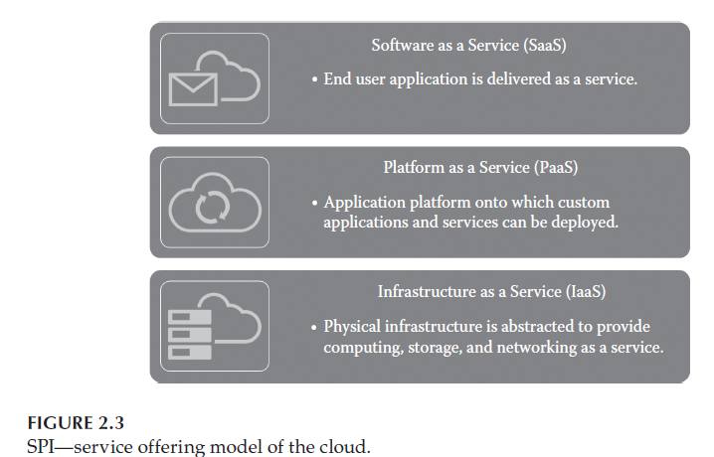
Three Service Offering Models
.

Slide 31
Continue…
Cloud SaaS: The capability provided to the consumer is to use the provider’s applications running on a cloud infrastructure, including network, servers, operating systems, storage, and even individual application capabilities, with the possible exception of limited user-specific application configuration settings.
The applications are accessible from various client devices through either a thin client interface, such as a web browser (e.g., web-based e-mail), or a program interface.
The consumer does not manage or control the underlying cloud infrastructure. Typical applications offered as a service include customer relationship management (CRM), business intelligence analytics, and online accounting software.
.

Slide 32
Continue…
2. Cloud PaaS: The capability provided to the consumer is to deploy onto the cloud infrastructure consumer-created or acquired applications created using programming languages, libraries, services, and tools supported by the provider.
The consumer does not manage or control the underlying cloud infrastructure but has control over the deployed applications and possibly configuration settings for the application-hosting environment.
In other words, it is a packaged and ready-to-run development or operating framework. The PaaS vendor provides the networks, servers, and storage and manages the levels of scalability and maintenance. The client typically pays for services used. Examples of PaaS providers include Google App Engine and Microsoft Azure Services.
.

Slide 33
Continue…
3. Cloud IaaS: The capability provided to the consumer is to provision processing, storage, networks, and other fundamental computing resources on a pay-per-use basis where he or she is able to deploy and run arbitrary software, which can include operating systems and applications.
The consumer does not manage or control the underlying cloud infrastructure but has control over the operating systems, storage, and deployed applications and possibly limited control of select networking components (e.g., host firewalls).
The service provider owns the equipment and is responsible for housing, cooling operation, and maintenance. Amazon Web Services (AWS) is a popular example of a large IaaS provider.
.

Slide 34
Difference between PaaS and IaaS
The major difference between PaaS and IaaS is the amount of control that users have.
In essence, PaaS allows vendors to manage everything,
while IaaS requires more management from the customer side.
Generally speaking, organizations that already have a software package or application for a specific purpose and want to install and run it in the cloud should opt to use IaaS instead of PaaS.
.

Slide 35
Thank You
For Your Attention…

